Slide 1

MORE FOOD = LESS WEIGHT?
2023/07/03
Liu Hongyu

Slide 2
More Food = Less Weight ?
by Liu Hongyu

Slide 3
Contents.
01.
02.
Introduction
项目概况
单击此处添加正文
03.
04.
产品与服务
市场分析
单击此处添加正文
单击此处添加正文

Slide 4
Introduction
Part I

Slide 5


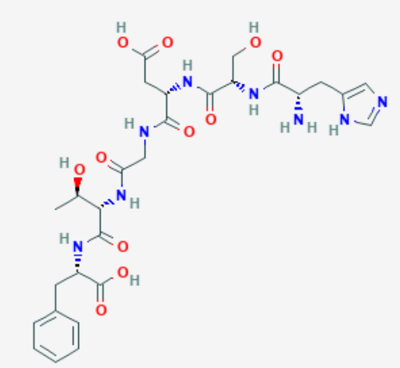

Secretin
Secretin is synthesized and secreted by S cells in the small intestine, and neurons in the brain. Secretin release is mainly stimulated by gastric acid delivered into the duodenal lumen. In addition, secretin is released by digested products of fat and protein.
Function:
It inhibits gasrtic emptying to delay the acid contents of stomach to enter in the duodenum(十二指肠).
It inhibits gasrtic secretion.
It acts on pancreatic duct to produce large colume of watery, NaHCO₃ secretion.
It stimulates the secretion of NaHCO₃ rich bile in the liver by acting on the bile ducts.

Slide 6
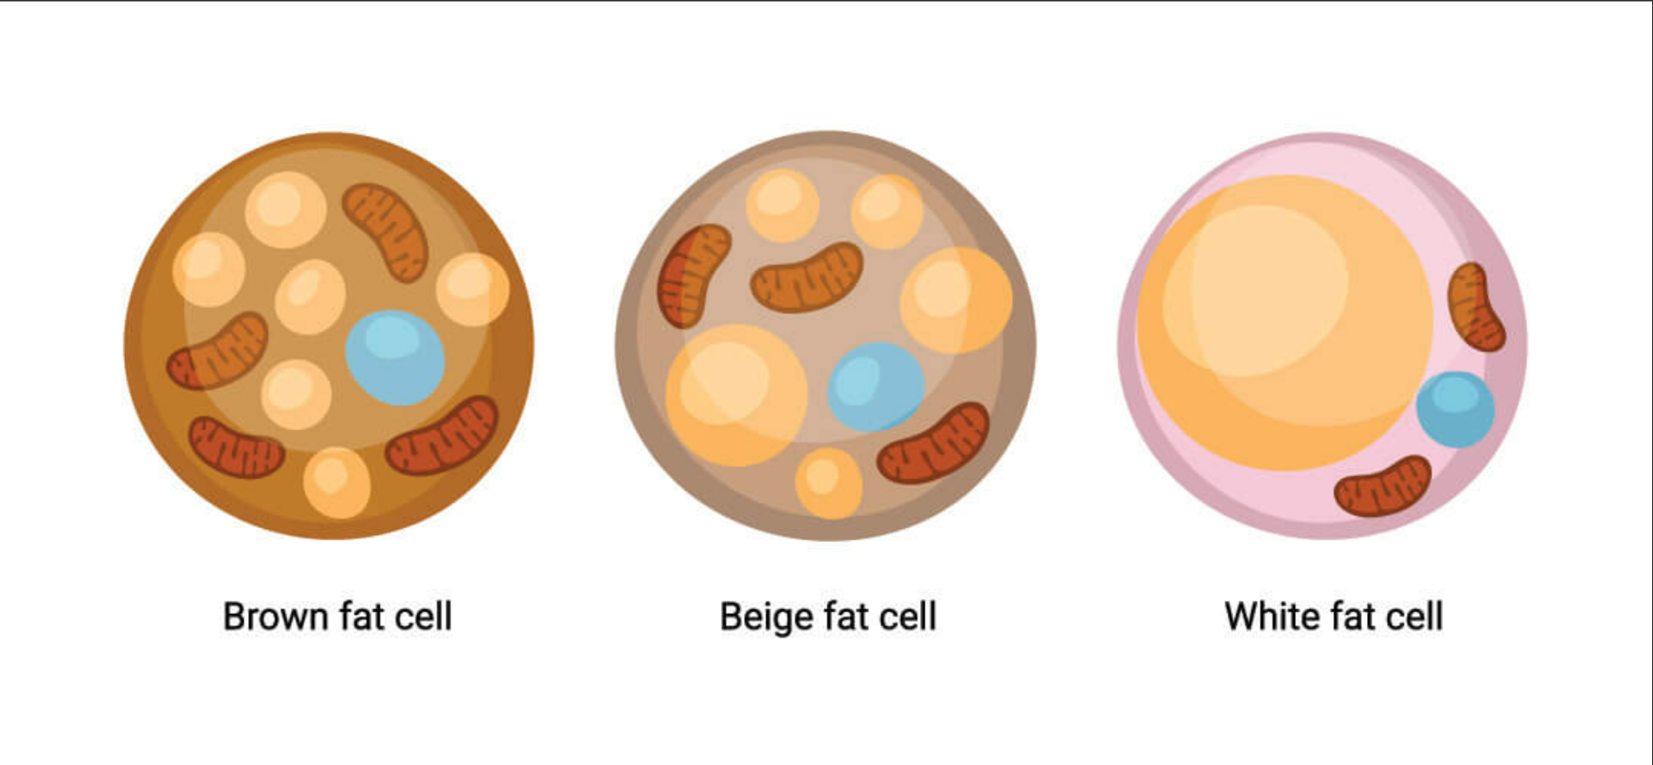
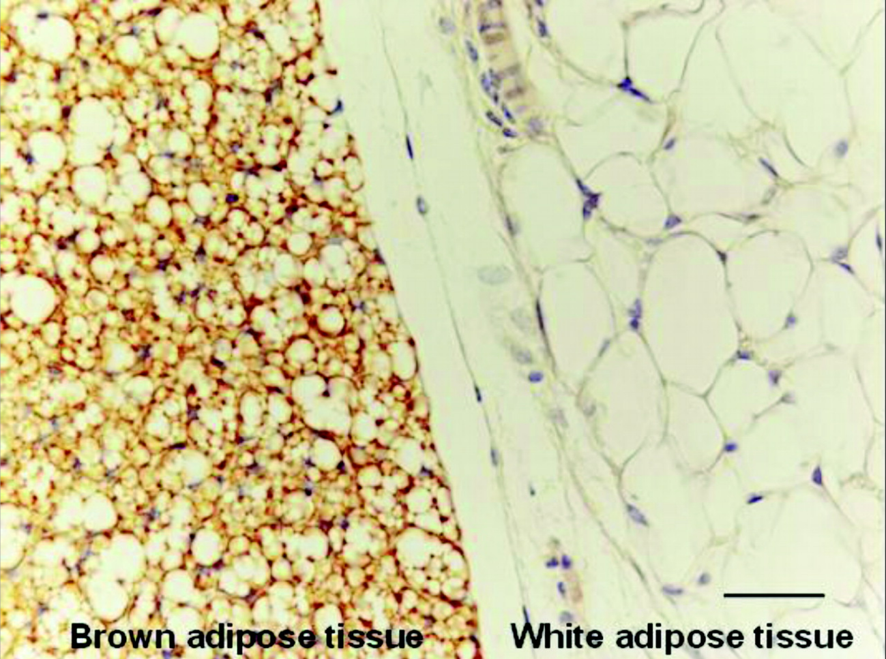
BAT(brown adipose tissue)
Brown adipose tissue (BAT) is ubiquitous in newborns and plays an important role in thermogenesis.
Brown adipose tissue is a uniquely mammalian tissue that protects neonatal body temperature around the time of birth by combusting triglycerides in the numerous mitochondria to emit heat.
The process can occur because of the presence in the mitochondrial inner membrane of the UCP1, which transports proton (equivalents) across the membrane to dissipate the proton gradient formed during substrate oxidation.

Slide 7
Secretin Induces Satiation
Part II

Slide 8
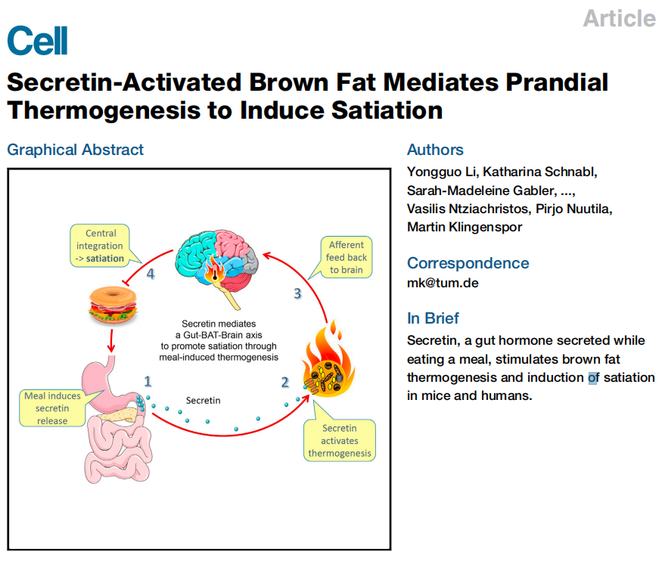

Slide 9
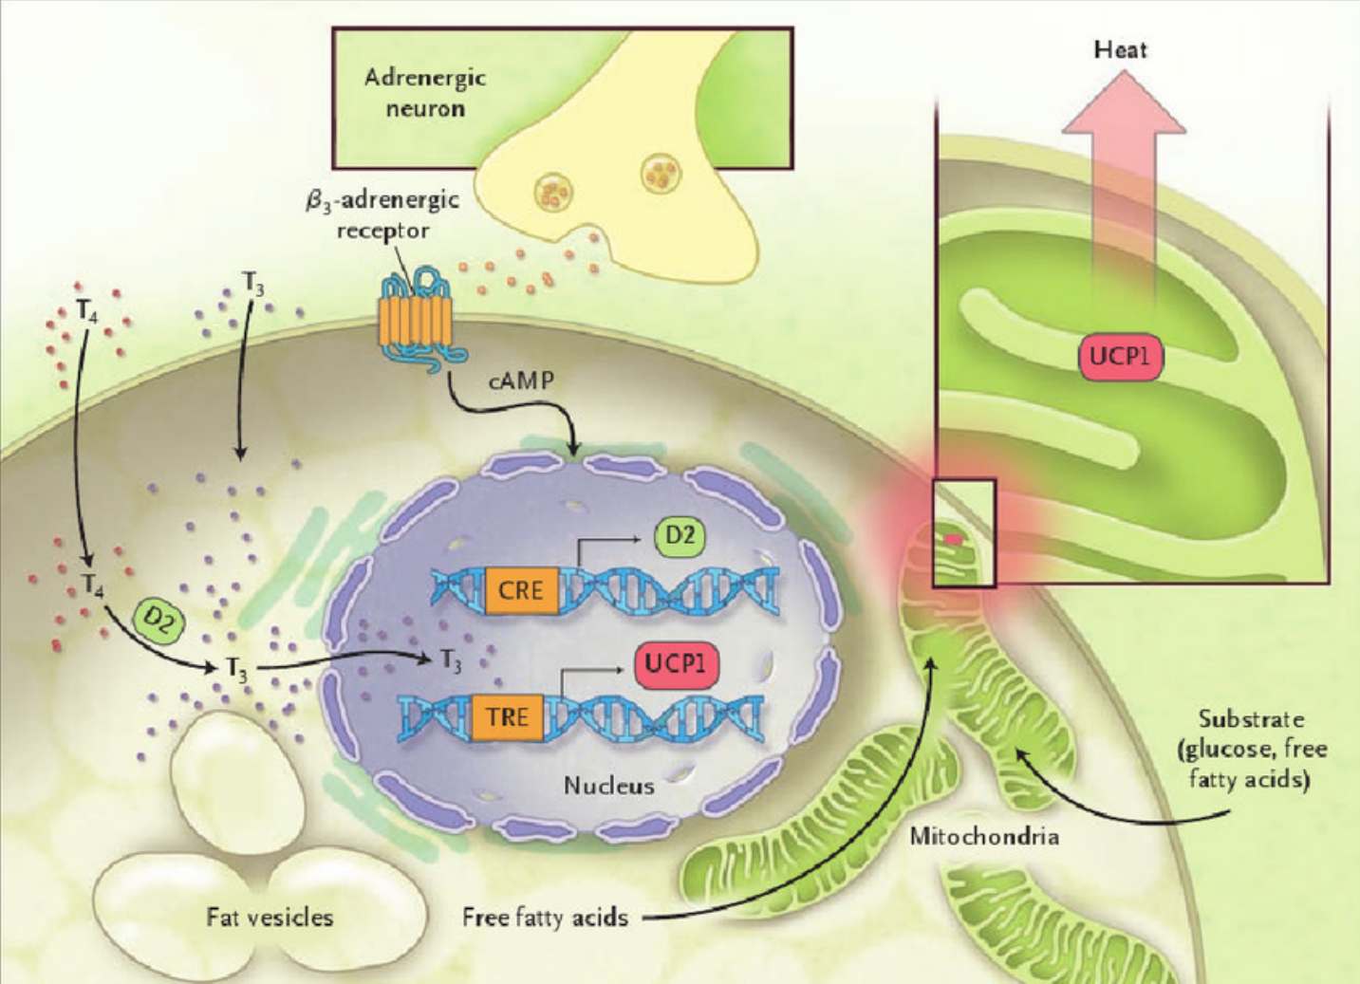
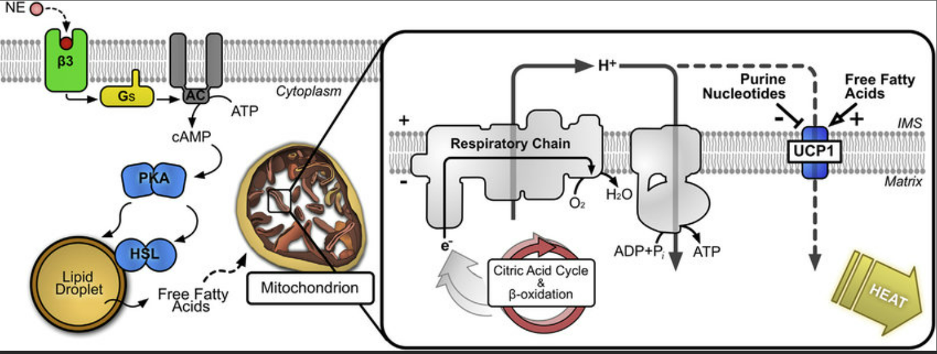
BAT thermogenesis
It is generally believed that an increased periprandial tone of the sympathetic nervous system (SNS) stimulates norepinephrine release from sympathetic nerves in BAT and activates canonical cAMP-PKA (cyclic AMP-protein kinase A) signaling via b3-adrenergic receptors (b3-ARs).This pathway activates lipolysis, UCP1, and non-shivering thermogenesis
UCP1 short-circuits the electron transport chain, allowing mitochondrial membrane potential to be transduced to heat, making BAT a tissue capable of altering energy expenditure and fuel metabolism in mammals without increasing physical activity.
Notes:
一般认为，交感神经系统（SNS）餐周张力增加刺激BAT交感神经释放去甲肾上腺素，并通过b3-肾上腺素能受体（b3-ARs）激活规范cAMP-PKA（环AMP蛋白激酶A）信号传导。该途径激活脂肪分解、UCP1 和非颤抖产热
UCP1使电子传递链短路，允许线粒体膜电位转导为热量，使BAT成为能够在不增加体力活动的情况下改变哺乳动物能量消耗和燃料代谢的组织。

Slide 10
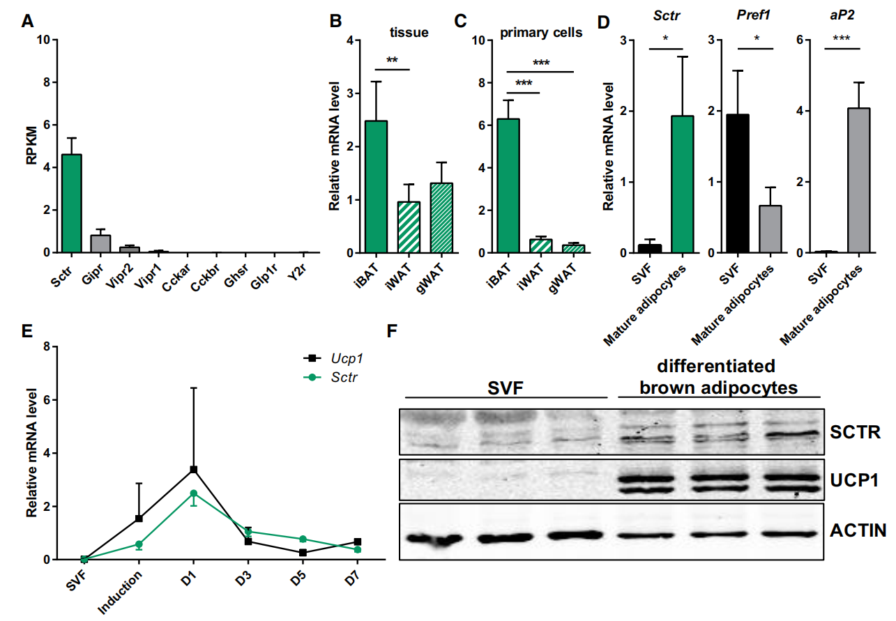
Abundant Expression of the Secretin Receptor in Brown Adipocytes
iBAT: interscapular BAT
iWAT: inguinal
eWAT: epididymal
Sctr: secretin receptor
SVF: undifferentiated stromal vascular cells
(A) Profiling of gut hormone receptors expressed in murine brown adipose tissue (BAT) using RNA sequencing (RNA-seq) data(n = 4).
(B and C) Relative expression levels of Sctr in BAT and inguinal (iWAT) and epididymal (eWAT) white adipose tissues as well as primary cultures (C) derived from these fat depots assessed by qPCR (n = 5).
(D) Relative expression abundance of Sctr, Pref1 (preadipocyte factor 1), and aP2 (adipocyte protein 2) in stromal vascular fraction (SVF) and mature adipocytes(n = 3).
(E) Time course expression of uncoupling protein 1 (Ucp1) and Sctr mRNA during brown adipocyte differentiation (n = 3).
(F) Western blot analysis of SCTR, UCP1, and b-actin in both SVF and differentiated brown adipocytes. Data are presented as means ± SD.
Notes:
该基因编码的蛋白质是G蛋白偶联受体，属于胰高血糖素-VIP-促胰液素受体家族。它结合促胰液素，促胰液素是胰碳酸氢盐，电解质和容量分泌的最有效调节剂。促胰液素及其受体被认为与胰腺癌和自闭症有关。

Slide 11
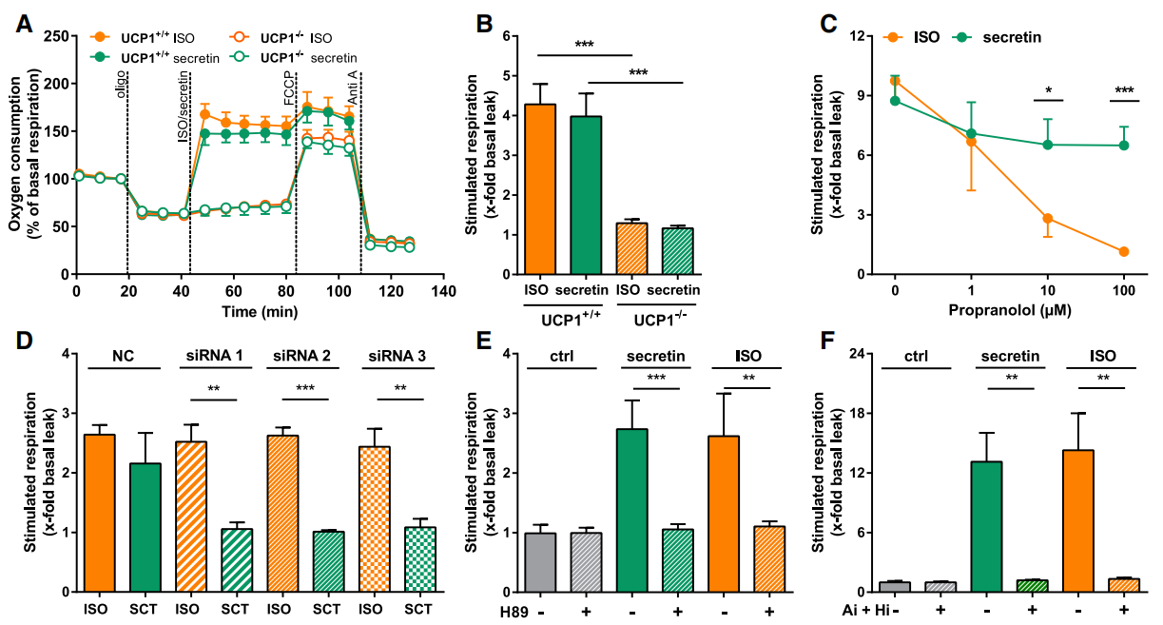
Secretin Activates Thermogenesis
secretin at a 50-fold lower concentration is as potent as isoproterenol (ISO), a β-AR agonist, in stimulating thermogenesis
UCP1-mediated uncoupled respiration expressed as fold increase of basal leak respiration after stimulation with ISO, secretin, and vehicle (assay medium) without PKA inhibitor H89
Secretin-induced thermogenesis depends on the activation of lipolysis through the canonical cAMP-PKA pathway
Notes:
Propranolol: 一种beta受体阻断剂 nonselective b-AR antagonist

Slide 12
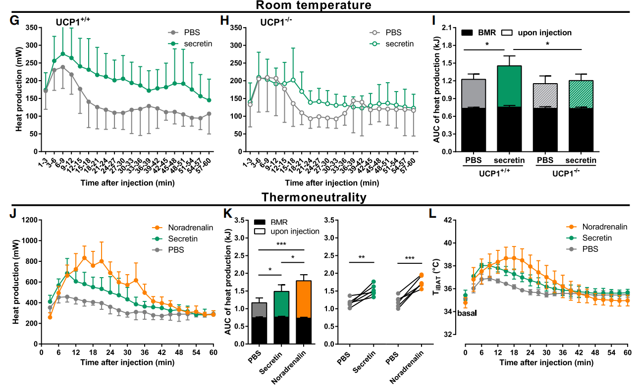
Secretin Activates Thermogenesis
(G–I) The thermogenic effect of secretin in UCP1+/+ (G) and UCP1-/- (H) mice kept at room temperature.
(J–L) The thermogenic effects of secretin (5 nmol), noradrenalin (1 mg/kg), and PBS on mice acclimatized for 1 week to thermoneutrality (30℃).

Slide 13
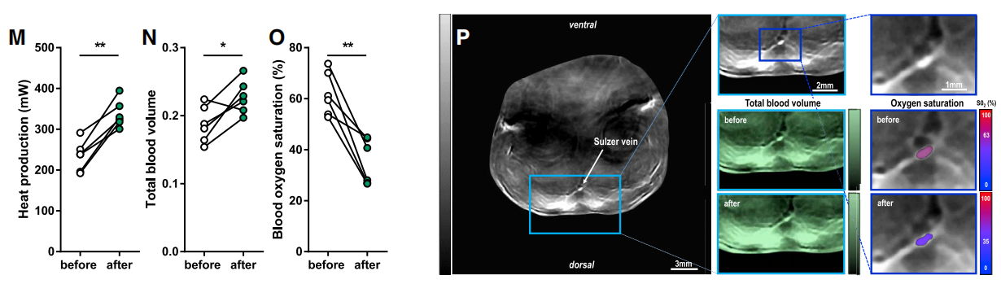
Secretin Activates Thermogenesis
Total blood volume (TBV) was increased whereas relative oxygen saturation (SO2) was dramatically decreased after secretin stimulation.
Secretin activates iBAT thermogenesis in vivo.

Slide 14
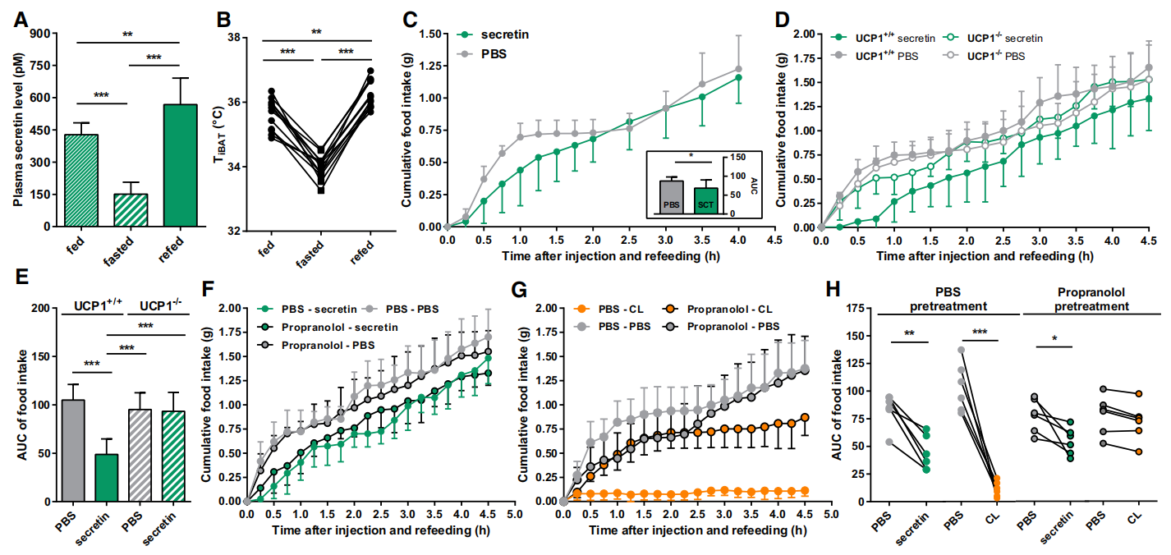
Secretin-Activated BAT Induces Satiation
Notes:
a, 禁食18h ｜ 禁食17h后喂食1h 血浆中secretin水平
b, 横坐标：fed, 任意时刻喂食1h；fasted, 在refeeding前1h；refed, refeeding之后的1h
c, 重新喂食前，分别注射5 nmol pbs或secretin，再喂食的前2小时内，secretin组的摄食明显减少，但之后差距不大，猜测其半衰期较短
d-e, 比较了分泌素对UCP1 WT和KO小鼠食物摄入量的影响。值得注意的是，UCP1-KO小鼠的分泌素对食物摄入量的抑制作用减弱（图3d和3E）。
分泌素诱导的BAT产热加速了饱足。这种饱腹感效应可以是通过直接激活BAT或通过分泌素激活对BAT的交感神经输出的中枢效应来介导的。
f-h, b3-AR激动剂CL-316243（CL）处理，secretin影响增大 食物摄入量（图3F-3H）

Slide 15
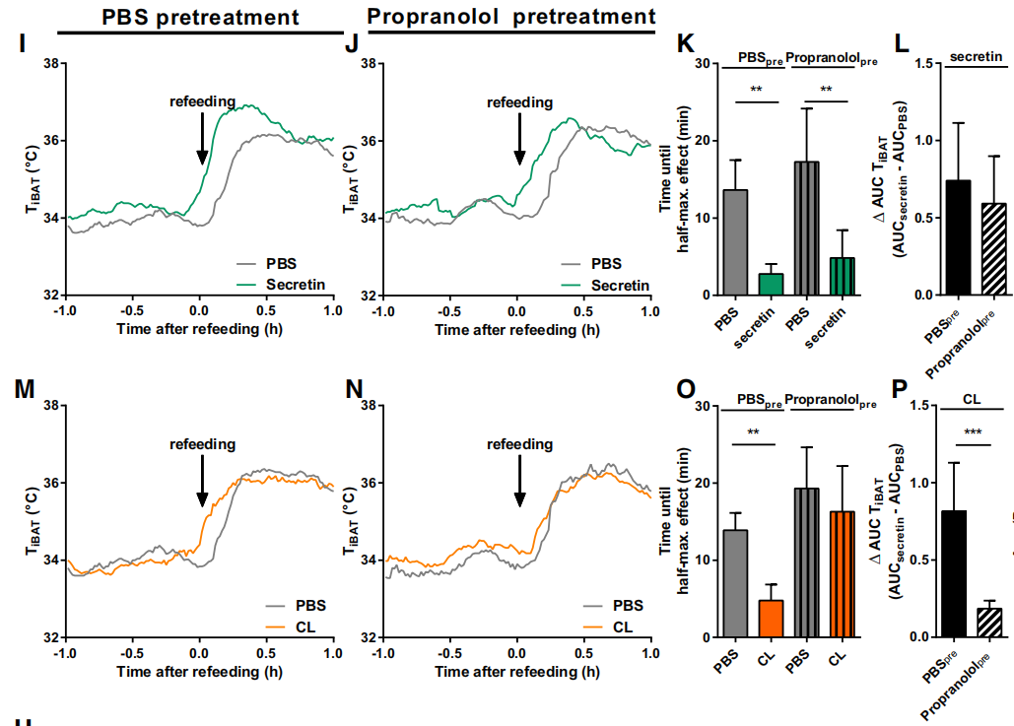
Secretin-Activated BAT Induces Satiation
In contrast to the effect of b3-AR agonist CL-316,243 (CL), the effects of secretin on food intake and BAT temperature, however, were retained in mice pretreated with propranolol.
Notes:
i-p, 分泌素对食物摄入量（图3F-3H）和BAT温度（图3I-3P）的影响在用心得安预处理的小鼠中仍然保留。
分泌素直接激活BAT，而不依赖于传出的交感神经支配。与之前的研究结果一致（Grujic等人，1997；Susulic等人，1995），肾上腺素能信号（CL）激活BAT也会导致食欲的抑制，这表明饱腹感是BAT产热的一般结果。
propranolol使CL-induced Tibat延迟升高，但对secretin-induced不delay

Slide 16
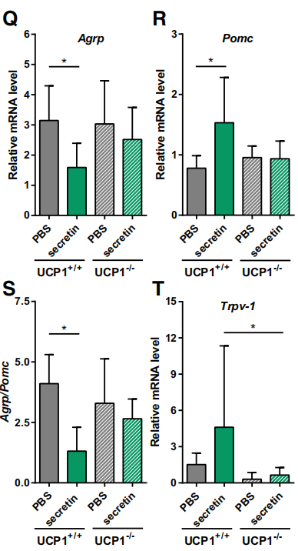
Secretin-Activated BAT Induces Satiation
POMC: anorexigenic proopiomelanocortin
AgRP: orexigenic agouti-related protein
Trpv-1: transient receptor potential vanilloid 1, a temperature-sensitive ion channel expressed in POMC neurons
Together, these results suggest that the satiation signal emanating from secretin-activated BAT was sensed in the brain and promoted satiation, likely through perception of heat generated by BAT.
Notes:
pomc，抑制食欲的基因水平下调
agrp，促食欲的上调
trpv-1，pomc的受体，在WT的下丘脑中表达上调，而在UCP1-KO小鼠中表达不上调

Slide 17
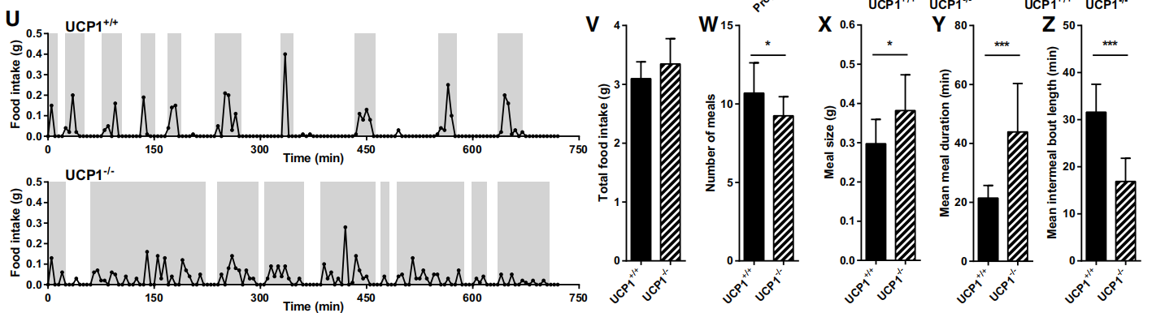
Secretin-Activated BAT Induces Satiation
Total food intake (V)
Number of meals (W)
Mean meal size (X),
Mean meal duration (Y)
Mean inter-meal bout length (Z)
Notes:
UCP1-KO小鼠在进食行为上表现出显著的改变，即餐数减少、餐量和餐时间增加、餐间回合长度减少，而总食物摄入量与WT小鼠相似
对黑暗期（n = 12）的总食物摄入量(V)、餐数(W)、平均餐量(X)、平均餐时间(Y)和平均餐间回合时间(Z)进行量化。
综上所述，分泌素通过直接激活BAT产热来抑制食物摄入，从而传递了BAT在控制饱足感方面的一种未被重视的功能。

Slide 18
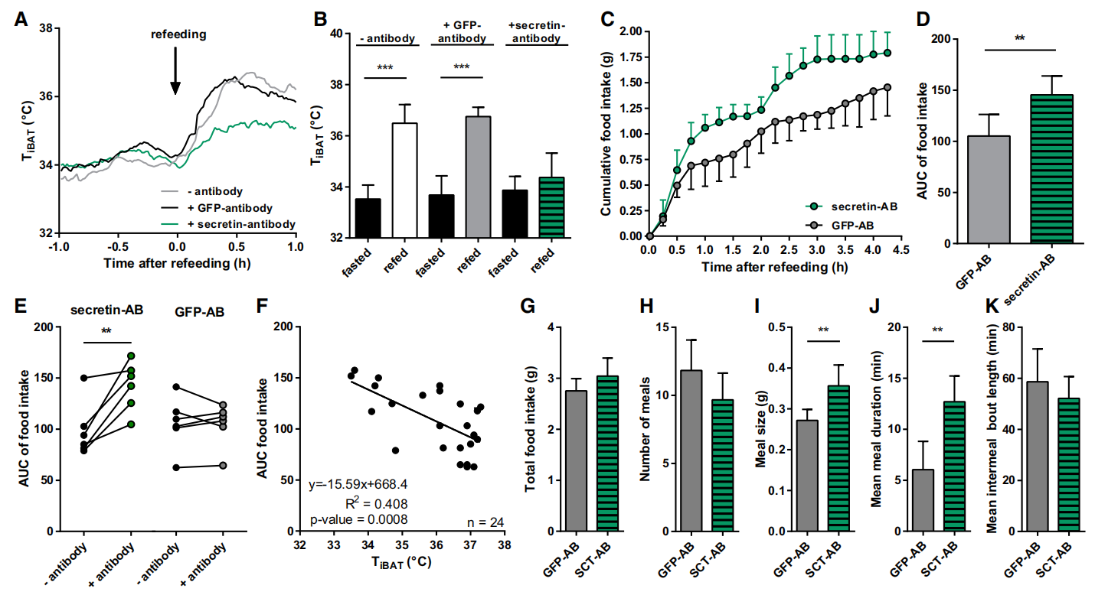
Neutralizing Prandial Secretin Activity Blunts Meal Associated Thermogenesis, Increases Food Intake, and Changes Meal Patterning
a novel endocrine gut-secretin-BAT brain axis in the acute control of food intake
Notes:
一种多克隆分泌素抗体来中和分泌素的内源性活性。在体外测试中，该抗体完全中和了纯化的分泌素以及内源性血源性分泌素介导的SCTR信号的激活
a-b, 与用同型样抗GFP抗体处理的小鼠相比，用分泌素抗体预处理的小鼠中iBAT温度的升高明显减弱（图4a和4B）。
c-e, 该抗体还增加了在再喂养的早期阶段的食物摄入量
f, iBAT温度的升高与食物摄入量之间呈负相关（图4F）
我们的研究结果证明了一种新的内分泌肠道分泌素-bat脑轴在食物摄入的急性控制中。
g-k, 通过分析在自由喂养条件下用分泌素抗体处理的WT小鼠的进食行为，我们发现这些WT小鼠通过增加进食量和延长进食时间来复制了UCP1-KO小鼠（图4G-4K）即通过抗体抑制SCT的小鼠表现出和UCP1-KO小鼠相似的行为

Slide 19
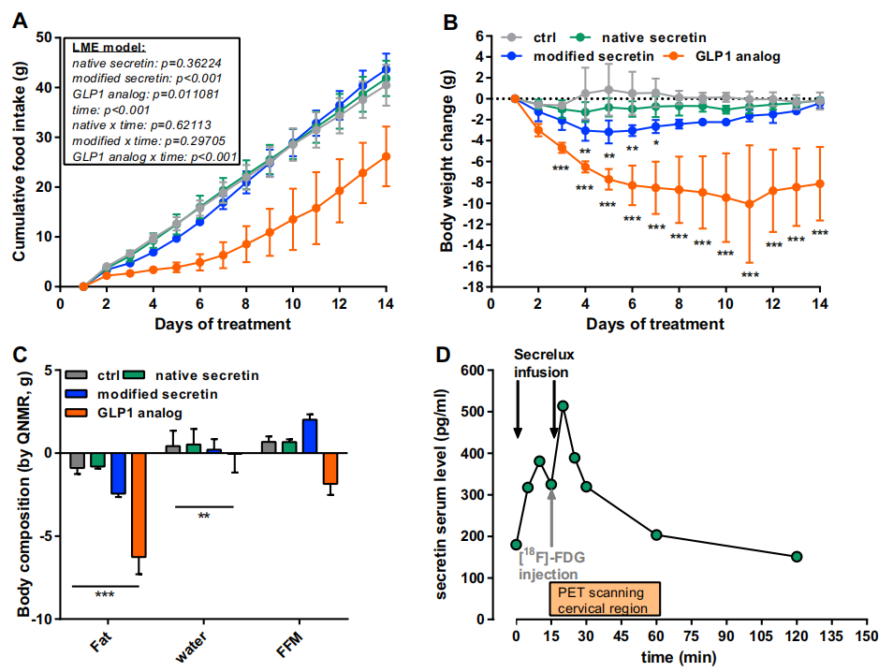
Secretin Infusion Transiently Elevates Energy Expenditure in Diet-Induced Obese Mice
Chronically infuse diet-induced obese mice (DIO) with native human secretin (native secretin) and a modified human secretin analog (modified secretin), respectively.
Notes:
长期饮食诱导的肥胖小鼠（DIO）分别注入天然人类分泌素（天然分泌素）和改良的人类分泌素类似物（修饰分泌素）。在室温下对DIO小鼠进行的第一个实验中，改良的分泌素导致了累积食物摄入量的小幅短暂减少（图S6A）和体重增加（图S6B）。治疗2周后，经修饰分泌素处理的小鼠的体脂质量略低。这并没有反映在较低的体重上，因为这些小鼠的瘦质量略有增加（图S6C）。

Slide 20
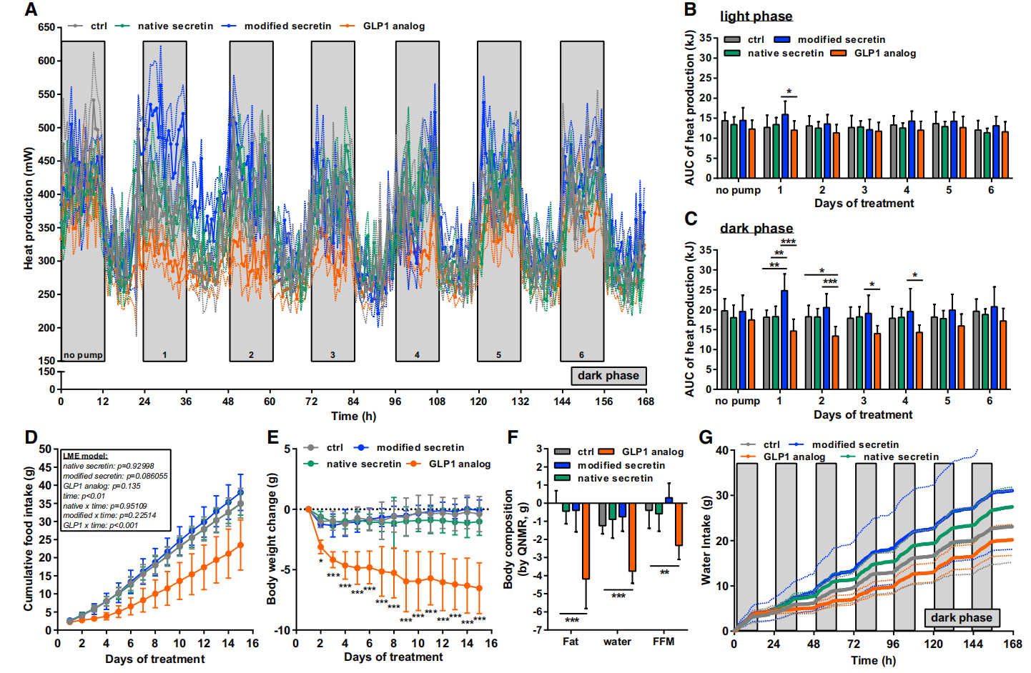
Neutralizing Prandial Secretin Activity Blunts Meal Associated Thermogenesis, Increases Food Intake, and Changes Meal Patterning
continuous infusion of native secretin (996 nmol/kg/day), modified secretin (326 nmol/kg/day), GLP1 analog (CEX51, 30 nmol/kg/day), or vehicle (20 mM Citrate) on metabolic parameters.
Notes:
a-c, 持续输注天然分泌素（996nmol/kg/天）、改良分泌素（326nmol/kg/天）、GLP1类似物(CEX51、30nmol/kg/天）或载体(20 mM柠檬酸）对代谢参数（如热量产生（A-C）、累积食物摄入量）的影响

Slide 21
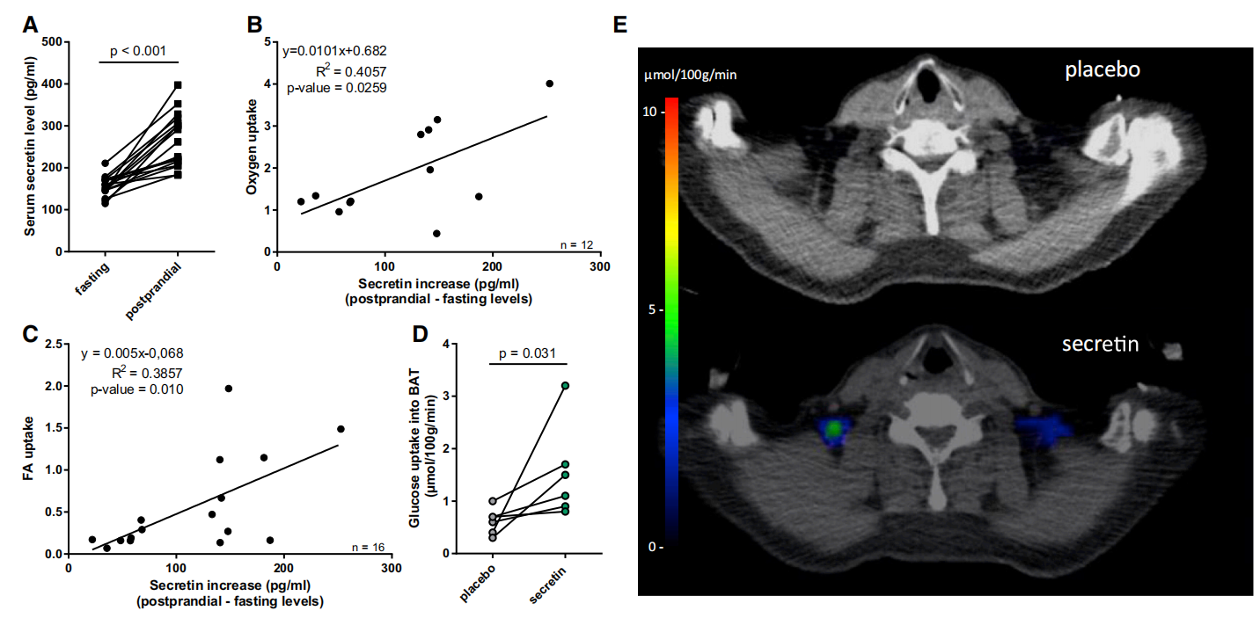
Secretin Activates Human BAT
Notes:
单餐摄入后血清分泌素水平增加（图6A）。单餐诱导的血浆分泌素水平的增加与BAT的餐后耗氧率和脂肪酸摄取率呈正相关（图6b和6C）。与安慰剂对照组相比，FDG-PET-CT扫描在两次分泌素注射后，通过BAT获得了分泌素生热作用的直接证据，显著提高了人BAT的血清分泌素水平（图S6D）和葡萄糖摄取（图6D）。总的来说，我们认为从小鼠到人，BAT通过分泌素激活引发的饱腹轴是保守的。

Slide 22
分泌素在进食过程中释放，直接激活BAT的产热作用。分泌素通过在棕色脂肪细胞中大量表达的分泌素受体发出信号来执行这种生热作用。
由膳食诱导的血液分泌素水平升高所编码的营养状态直接转化为BAT的生热活性，从而将这些信息传递给大脑并促进饱足。这建立了一个未知的内分泌肠道分泌素-bat脑轴，对整合能量平衡生理学具有重要意义。

Slide 23
Thanks !

